Slide 1
Introduction to Cisco Packet Tracer
Week 3

Slide 2
Cisco Packet Tracer
Powerful network simulator tool
Create networks with an almost unlimited number of devices
Allows troubleshooting without having to buy real Cisco routers or switches
Offers students a tool to learn the principles of networking as well as develop Cisco technology specific skills
Developed at Cisco Systems

Slide 3
Network Topology
Network topology is the arrangement of the elements (links, nodes, etc.) of a communication network. Network topology is the topological structure of a network and may be depicted physically or logically.

Slide 4
IPv4 Five Classes
 | Public IP Range | Private IP Range | Subnet Mask | # of Networks | # of Hosts per Network
Class A | 1.0.0.0 to 127.0.0.0 | 10.0.0.0 to 10.255.255.255 | 255.0.0.0 | 126 | 16,777,214
Class B | 128.0.0.0 to 191.255.0.0 | 172.16.0.0 to 172.31.255.255 | 255.255.0.0 | 16,382 | 65,534
Class C | 192.0.0.0 to 223.255.255.0 | 192.168.0.0 to 192.168.255.255 | 255.255.255.0 | 2,097,150 | 254
Notes:
Class A IPs are written with /8 representing 8 network bits , B with /16 and C with /24.

Slide 5
IPv4 Classes (continued..)
Class D (Range: 224.0.0.0 to 239.255.255.255) and E (Range: 240.0.0.0 to 255.255.255.255) are reserved
Private IP addresses are reserved specifically for private/internal use only
Subnet mask:
32-bit number created by setting host bits to all 0s and setting network bits to all 1s
Identifies the host device operating on that network
Gateway IP:
A network node used in telecommunications
Serves as an entry and exit point for a network as all data must pass through or communicate with the gateway prior to being routed

Slide 6
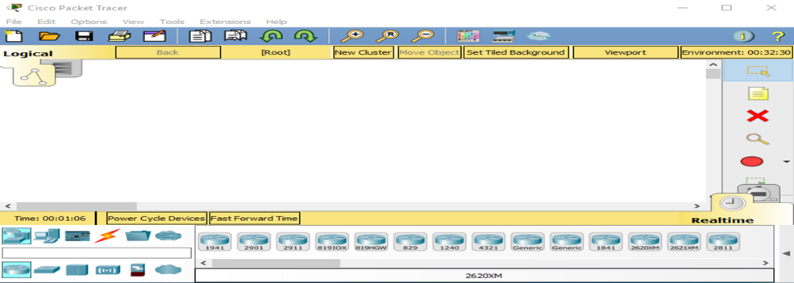
Launch Packet Tracer (PT)

Slide 7
Devices to be used in labs
Routers: 2811
Switches: 2960-24TT (or simple 2960)
End Devices: Generic (any PC or laptop)
Connections:
Copper Crossover: connecting similar devices
Copper Straight-through: connecting non-similar devices
Serial DTE: between routers
Network Interface Cards:
WIC-1ENET for one extra ethernet ports
WIC-2T for two serial ports for router connections

Slide 8
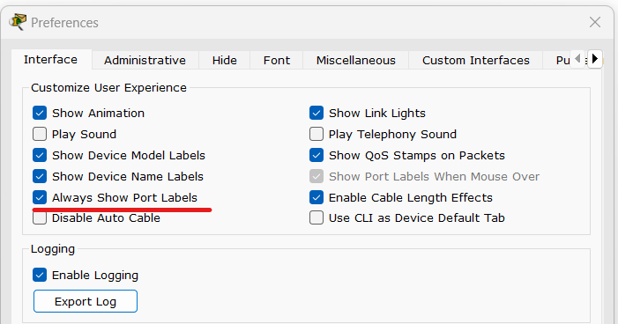
Enable Port Labels
Click on Options >> Preferences or Ctrl+R and enable the following option

Slide 9
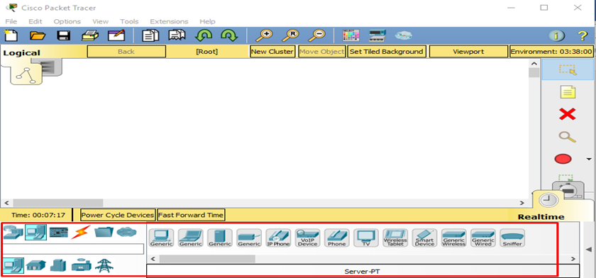
Select devices from here

Slide 10
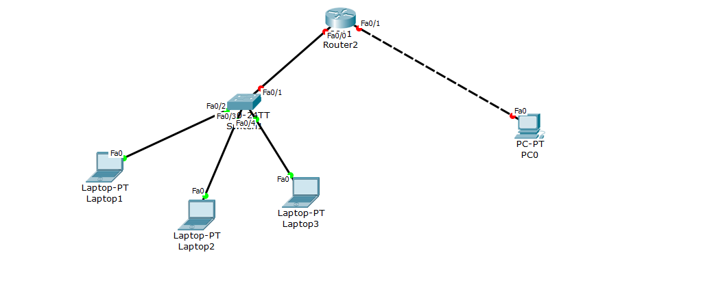
Create a single router topology
Single click on device to add and then on screen

Slide 11
Adding Network Interface Card (NIC)
By default there are two ethernet connections i.e., Fa0/0 and Fa0/1. To add more interfaces:
Click on router
Switch off router by button with green light
Drag the interface card in slot
Turn on router
Make connections
Notes:
Fa is Fast ethernet

Slide 12
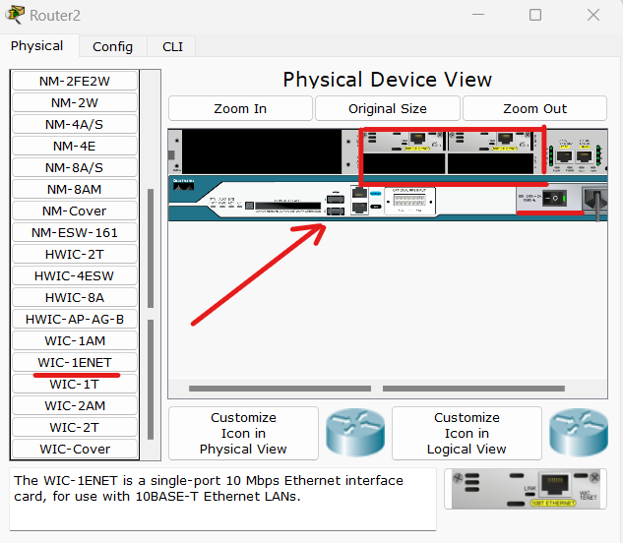
2
3

Slide 13
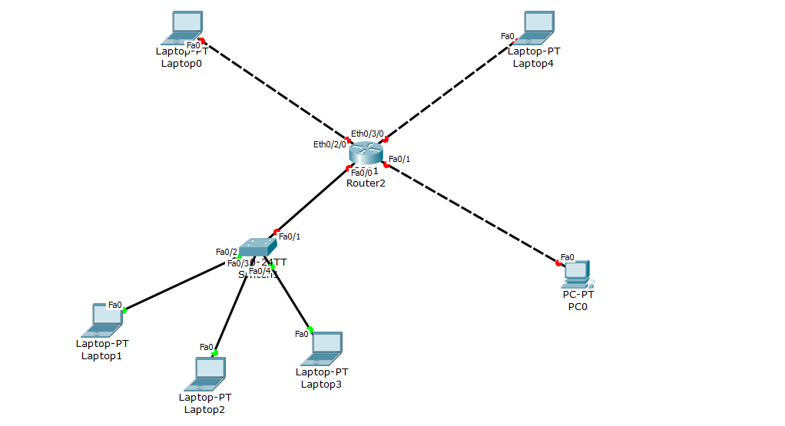
Lab Task Network Topology
Notes:
Switches are not configured

Slide 14
Configuration using Class C IPs
Click on router
Go to CLI
Write ‘no’ if option for continuing with dialog box is coming
Write following command for one port (e.g., Fa 0/1 or whatever you want):
Enable
Configure terminal
Interface Fa0/1
Ip address 192.168.1.1 255.255.255.0
No shutdown
Note: In the command “ Ip address 192.168.1.1 255.255.255.0 “ , gateway IP is written in 192.168.1.1 and subnet mask of considered ip in 255.255.255.0, so change it accordingly

Slide 15
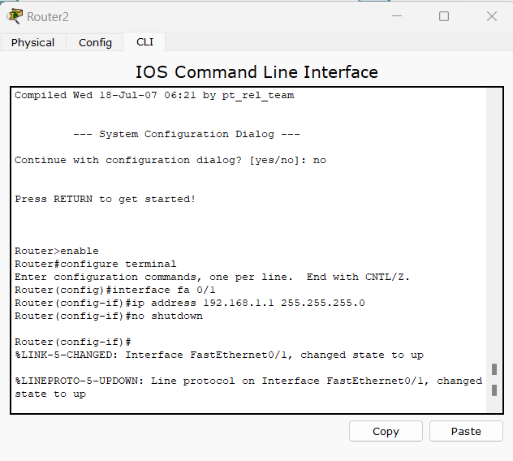

Slide 16
Lets Assign IP to PC0
Click on PC0 or according to your topology
Select “Desktop” from title bar
Click on “IP Configuration”
Write IP address for PC from network range
Mention subnet mask and gateway and close the screen
One configuration is completed

Slide 17
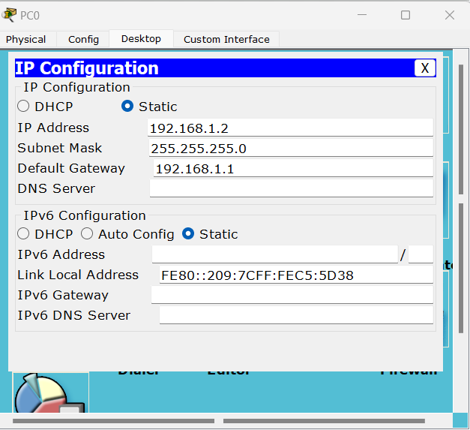

Slide 18
Lab Task
Compete rest of configurations with Class C IP addresses with respect to last two digits of your roll number. Send packets and check if it is successful and submit .pkt file with naming convention “i21-XXXX_Lab3.pkt”.
Use last two digits of your roll number as second octet. E.g. your roll number is 21I-0789 then assign rest of three gateways as 192.89.1.1 ,192.90.1.1 and 192.91.1.1 for three networks

